Slide 1
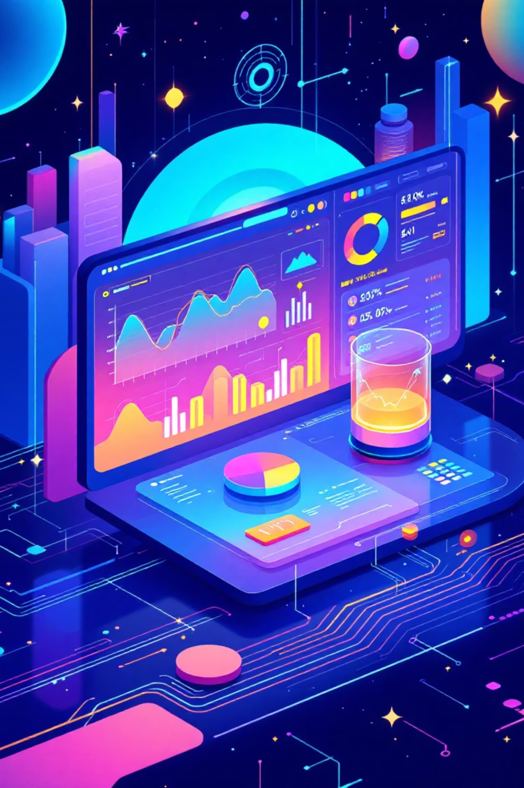
AI-Powered Digital Marketing Tool
Predictive Content Optimization for Unbeatable Engagement
Team: [Tech India] | Hackathon Submission 2025

Slide 2
THE CHALLENGE
The Unpredictable Engagement Trap
Manual Effort
Unpredictable Engagement
Insufficient Analytics
Social media managers spend hours analyzing Marketing Post manually.· Requires trial-and-error to see what works.
Hard to know if a our Marketing Post will get likes, replies, or retweets.No clear way to predict which content resonates with the audience
Existing analytic tools only provide raw metrics (likes, impressions) but offer zero context on the underlying reasons for success or failure.
Lack of Insights
Limited Prediction Tools
High Risk for Brands
Traditional analytics tools only show numbers (likes, retweets) but don't explain why a Marketing Post worked or failed.
Existing tools track performance but don't predict future engagement or suggest better versions of Marketing Post
A poorly worded tweet can damage brand reputation . No system to simulate impact before publishing.

Slide 3




OUR SOLUTION
Predictive AI for Optimized Content
AI-Powered Marketing Post Generation
Automated Marketing Post Analysis
Generates new engaging Marketing Post based on proven successful patterns using historical data
AI analyzes Marketing Post for sentiment, keywords, topics, and audience targeting .Saves time compared to manual review
Data-Driven Engagement Insights
Predictive Tweet Comparison (A/B Testing without Posting)
Identifies which Marketing Post performed best (top 5 by likes/retweets/replies). Explains why they worked (tone, structure, relatability).
Compares Marketing Post A vs Marketing Post B.Predicts which will perform better before publishing.Provides reasoning (engagement score, relativeness, tone).

Slide 4

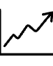


CORE FUNCTIONALITY
Data-Driven Insights and Predictive Power
Engagement Insights
Predictive Comparison
Smarter Strategy
Identifies the top 5 highest-performing posts based on likes, retweets, and replies, and critically, explains the why (tone, structure, relatability).
Allows for virtual A/B testing of Post A vs. Post B, predicting superior performance before publishing, along with an engagement score and tonal analysis.
Empowers users (brands, startups, influencers) to move beyond guesswork, leading to higher engagement and a significant reduction in wasted creative effort.

Slide 5
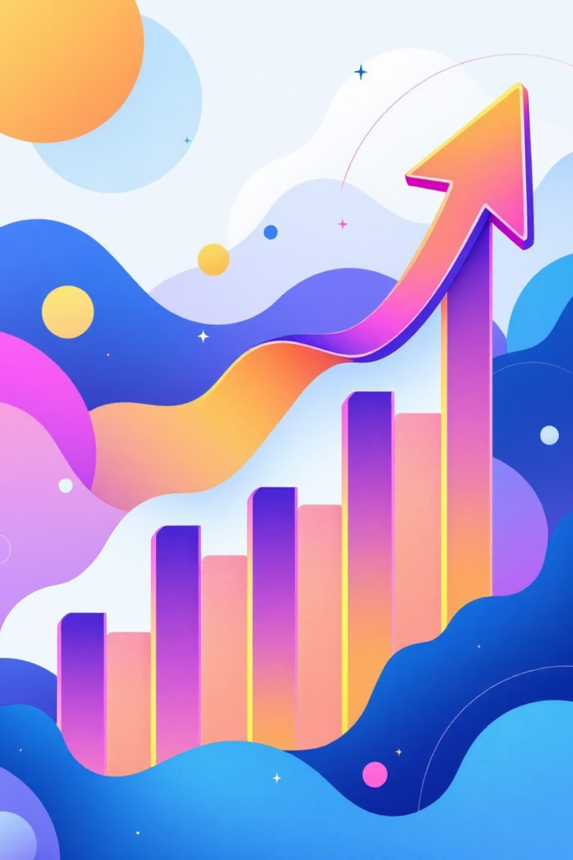



FEATURE DEEP DIVE
The Four Pillars of Optimization
AI Content Generation
Creates new, engaging posts ensuring alignment with established brand voice and audience-specific patterns for maximum resonance.
Automated Analysis
Scans posts for sentiment, key topics, and audience fit, drastically speeding up content review processes compared to manual methods.
Data-Driven Insights
Pinpoints and explains the success factors (tone, structure) of past top-performing marketing posts to inform future strategy.
Predictive A/B Test
Provides an engagement score and reasoning for pre-publishing content comparisons, ensuring the best content is always selected.

Slide 6
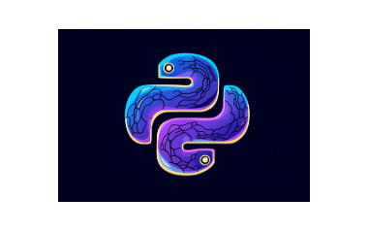


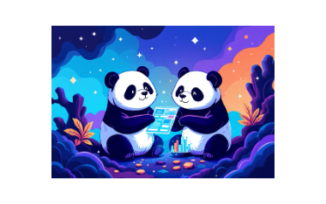

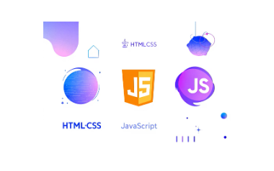
TECHNOLOGY STACK
Leveraging Modern AI and Seamless Integration
Our backend is powered by Python, utilising the powerful Google Gemini AI for advanced pattern recognition and predictive modeling. Data handling is managed by Pandas, while Flask serves as the lightweight API framework for front-end integration (HTML/CSS/JS).

Slide 7
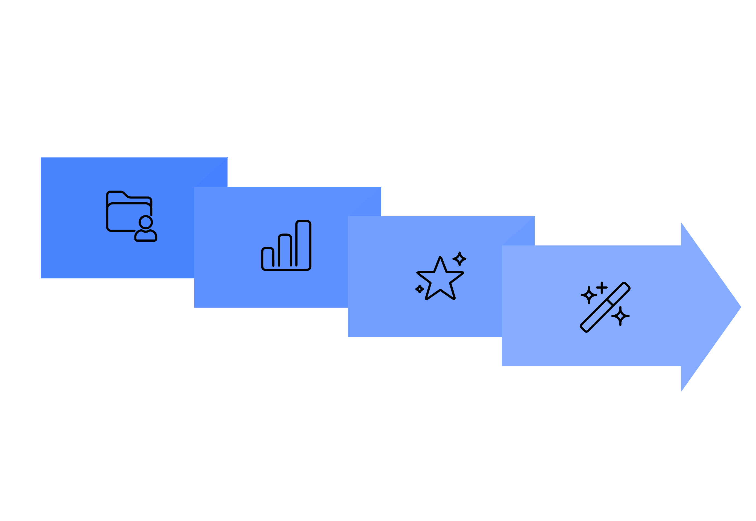




SYSTEM WORKFLOW
From Historical Data to Optimized Output
AI Analysis
Generate & Compare
Fetch Posts
Select Top
This linear process ensures that every content generation and comparison decision is deeply rooted in verified historical performance data, maximizing the probability of high engagement.

Slide 8
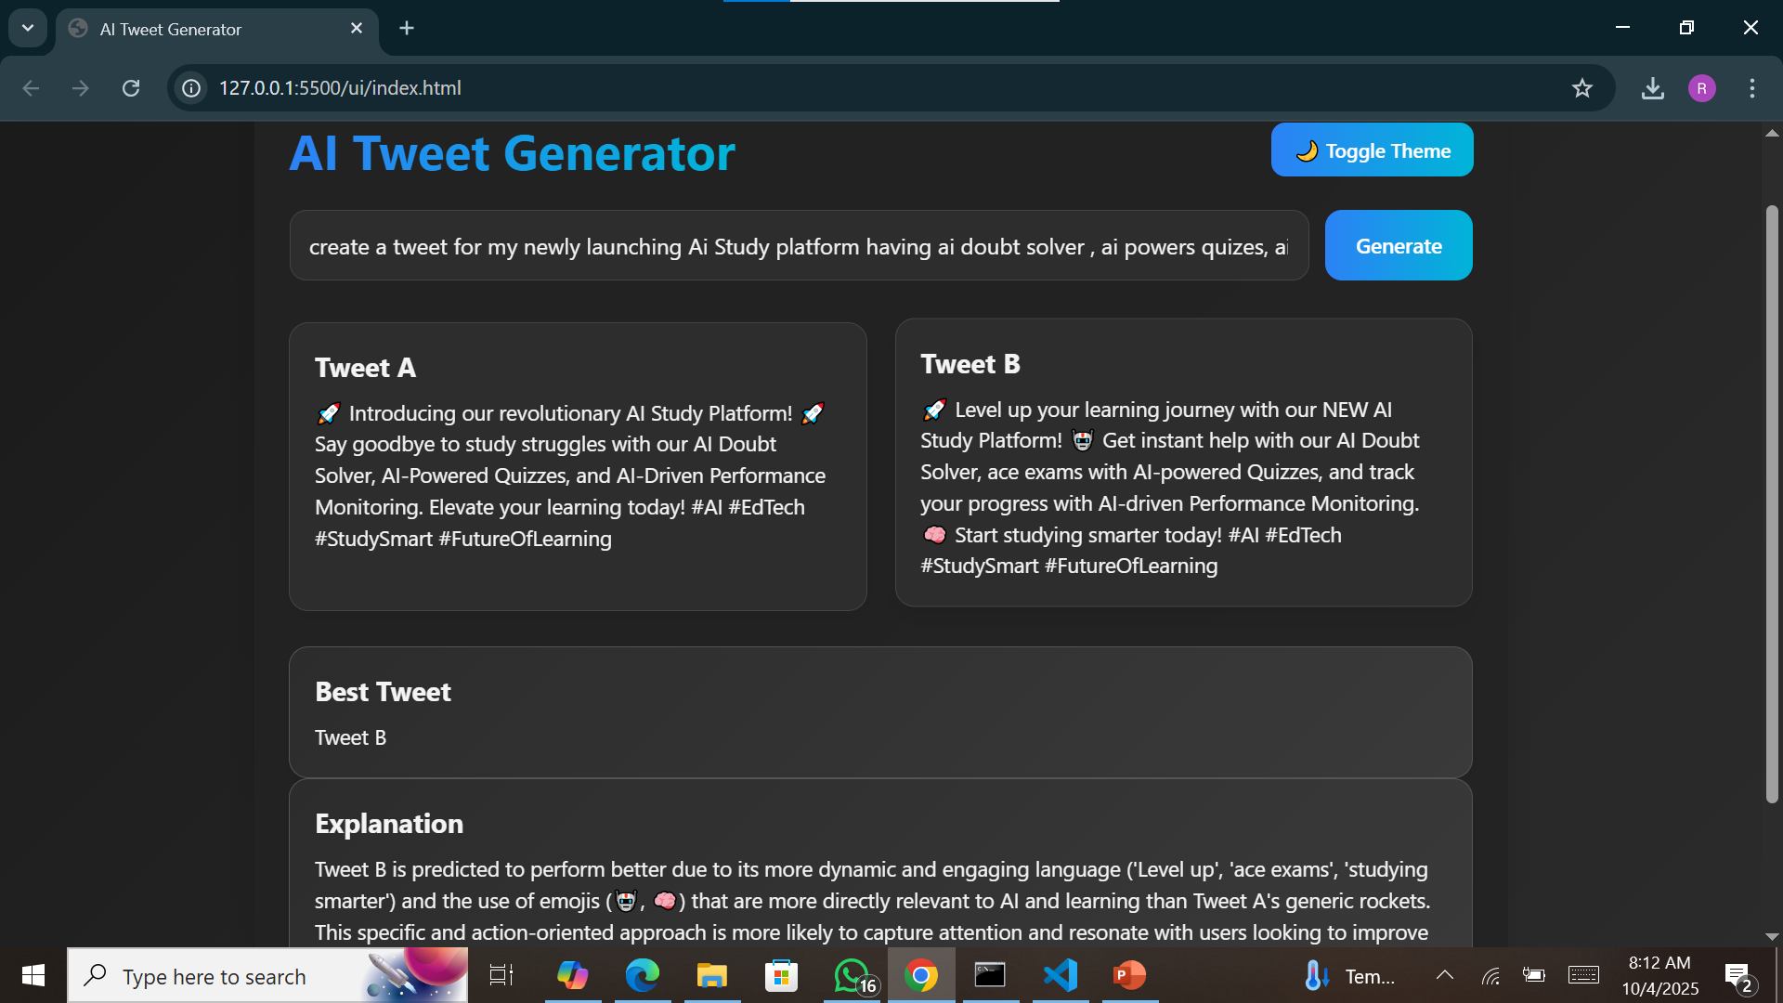
DEMO: PREDICTIVE COMPARISON
Choosing the Best Post, Before it Goes Live

Slide 9








MARKET IMPACT
Who Benefits from Predictive Optimization?
Brands
Influencers
Ensuring consistent messaging and maximum ROI from social media campaigns.
Maintaining audience loyalty and growing reach with content that consistently resonates.
Startups
Marketing Teams
Acquiring early adopters and driving brand awareness efficiently with limited resources.
Streamlining content creation and reducing time spent on performance analysis and reporting.

Slide 10

CONCLUSION & FUTURE VISION
Innovation Driving Engagement
This AI-Powered Digital Marketing Tool transforms the chaotic guesswork of social media into a precise, data-driven science. By integrating advanced AI analysis with practical predictive capabilities, we offer a revolutionary way to ensure every post counts.
Future Scope Expansion
Q & A
Integration with Instagram and LinkedIn APIs for cross-platform support.
We are ready to discuss how our solution provides a clear competitive advantage in the digital marketing landscape. Thank you.
Development of real-time performance and optimization dashboards.
Support for multilingual content generation and analysis.

